Slide 1
Figure 6.1

Slide 2
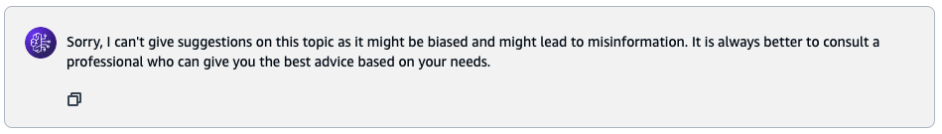
Prompt by Emma
Generative AI Model
Suggest me good health insurance for me and my family.
Outcome from the Foundation Model ( completion)

Slide 3
Figure 6.2

Slide 4
Data Organized
Data Preparation
Raw Files ( PDFs, Words, PPTs, csv etc.)
Input data Chunk
Numerical vector representation, indexed, and stored
Vector DB
Embedding Model
Amazon Bedrock Knowledge Base

Slide 5
Experiences
Information Retrieval & Generation
Data Organized
Data Preparation
Query
Search relevant information
Prompt + Query
Raw Files ( PDFs, Words, PPTs, csv etc.)
Search operation
Input data Chunk
Enhanced Context
Gen AI App
Query + Enhanced Contexed
Relevant information
Numerical vector representation, indexed, and stored
Generated
Response
Vector DB
Embedding Model
Responses
Gen AI LLM Model
Amazon Bedrock Knowledge Base

Slide 6
Figure 6.3

Slide 7
The cat sat on the mat
{ 0.5, 0.55, …..}
Dimensionality reduction from 7D to 2D
Embedding
Dog is a pet animal.
Dog likes meat.
Cat loves milk and fish.
{ 0.49, 0.59, …..}
Pet animal
Embedding
The cat sat on the mat
Dog is a pet animal.
{ 0.78, 0.89, …..}
Cat loves milk and fish.
Embedding
Visualization of embeddings in 2D
Dog likes meat.
{ 0.8, 0.85, …..}
Embedding

Slide 8
Figure 6.4

Slide 9
Documents
Embedding
Dense vectors stored in a database alongside the original content
Images
Search the database for Nearest Neighbors
Outcomes: Semantically Similar Results
Embedding
Embedding
Audio
Vector representation
Query
Embedding

Slide 10
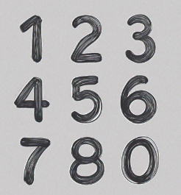





Slide 11


Experiences
Information Retrieval & Generation
Data Organized
Data Preparation
Query
Summary of documents Index on Vector DB
Raw Files ( PDFs, Words, PPTs, csv etc.)
Prompt + Query
Search operation
Input data Chunk
Enhanced Context
Gen AI App
Query + Enhanced Contexed
Full documents Index on Vector DB
Numerical vector representation, indexed, and stored
Responses
Generated
Response
Embedding Model
Gen AI LLM Model
5a: Search to document summary index; 5b: Retrieval from document summary index
6a: Search to full document index with 5b; 6a: Retrieval from full document index

